Slide 1
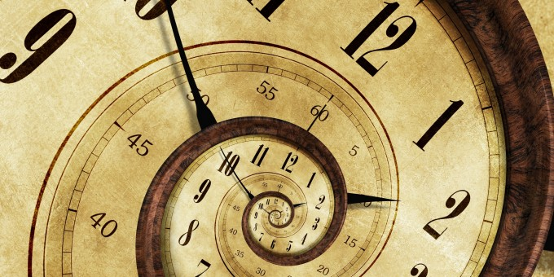

CLOCKS
© Department of Analytical Skills

Slide 2
CONCEPT BASE
DIAL:
The face or dial of a clock is a circle whose circumference is divided into 60 equal parts, called minute spaces.
They are marked by short lines in the face of the clock. However, the end of every fifth minute space is marked longer than the others and the 60 minute spaces are represented as 12 divisions or 12 hour spaces.

Slide 3
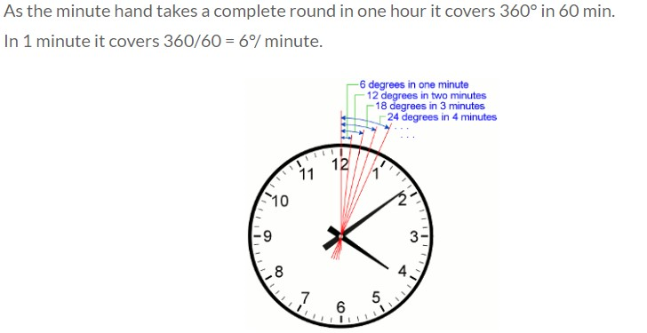

Slide 4
HANDS OF THE CLOCK:
A clock has two hands; the smaller one is called the hour hand or short hand while the larger one is called the minute hand or long hand as shown in the figure above.
The hands of the clock are the indicators of time.
The time is read based on the positions of the hands with respect to minute or hour spaces.

Slide 5
UNIT OF TIME:
The unit of time in clocks is seconds.
A second, the SI unit of time, is defined as the natural periodicity of the radiation of a caesium-133 atom.
A duration of 60 seconds is defined as a minute.
In clocks, it is also defined as the time taken by the minute hand to move across a minute space.
A duration of 60 minutes is defined as an hour.
In clocks, it is also defined as the time taken by the hour hand or short hand to move across five minute spaces or one hour space.
A day is also defined as the duration of 24 hours
The time is measured owing to the movement of the hands of a clock. A complete rotation of any of the hands would cover a measure of 360 degrees (circular displacement) .
Hour hand covers an angle of 360° in 12 hours. So, the hour hand in one hour will cover 360 /12 = 30°.
So for every minute, the hour hand moves through 30 /60 = 0.5 °.

Slide 6
Minute hand covers an angle of 360° in 1 hour. So for every minute, the minute hand moves through 360/60 = 6 °.
Both the hands of the clock move in same direction.
So, their relative displacement for every minute is 5.5° or 11/2°.
This 5.5° movement constitutes the movements of both the hands.
So for every minute, both the hands give a relative displacement of 5.5°.

Slide 7
FORMULA TO FIND THE ANGLE BETWEEN THE HANDS OF THE CLOCK:
Let us say in a race, Sam gives a head-start of 120 metres to Anand.
Sam and Anand run at the speed of 10 m/s and 6 m/s respectively.
Running in the same direction, the relative displacement is 10 − 6 = 4 metres for every second.
Now, let us calculate the time taken by
(i) Sam to catch up with Anand
(ii) Sam to lead Anand by 20 metres
Time taken by Sam to catch up with Anand
Once they begin to run, the initial gap of 120 metres starts decreasing at the rate (relative speed) of 4 m/s.
Therefore, it takes
4 × t = 120 (Relative Speed × Time = Relative distance or gap)
t = 30 secs to catch up with Anand or to say that they are at the same point.

Slide 8
(ii) Time taken by Sam to lead Anand by 20 metres:
We know that Sam needs 30 secs to catch up with Anand and thereby it can be considered that both of them are running, starting at the same point after 30 secs.
Though Sam runs at 10 m/s, the gap between them increases at the rate of their relative speed i.e. 4 m/s.
Hence, it takes 4 × t = 20, t = 5 secs to lead
Anand by 20 metres when they start from the same point.
Thus, from the starting point Sam takes
30 + 5 = 35 secs to lead Anand by 20 metres.
However, the answer can be directly found by taking the relative distance to be
120 + 20 = 140 metres
4 × t = 140
t = 35 secs.

Slide 9

From (i) and (ii), we can think of the hands of the clock as two runners running in a circular track of 360°. Here, the angle between the hands of the clock should be considered as the relative distance between them.
Therefore, we can formulate the following

Slide 10
𝜃=30°𝐻− 11/2𝑀
(when the minute hand is trailing the hour hand) 𝜃=11/2𝑀− 30°𝐻
(when the minute hand is leading the hour hand)
𝜃 = Angle between the hands of the clock
30°𝐻 = Initial gap; H - the division pointed by the hour hand which indicates the gap between the minute hand and hour hand initially when multiplied by 30°.
11/2𝑀 = Relative displacement for a period of time; 11/2 - Relative speed of the hands of the clock; M - no. of minute spaces moved by the minute hand.

Slide 11
COINCIDENCE OF THE HANDS OF THE CLOCK:
At 12 o' clock, the hands of the clock overlap i.e. the angle formed between them is 0°.
To find the next time they overlap, the gap between them should be 360° so that they are at the same point. Hence it takes,
11/2 × t = 360
t = 720/11 = 65 5/11 minutes
Thus, it can be easily concluded that the hands of the clock coincide every 65 5/11 minutes.

Slide 12
FREQUENCY OF FORMATION OF ANGLES BETWEEN THE HANDS OF THE CLOCK:
With the relative displacement, it is easier to find the frequency at which the hands of a clock form a particular angle.
Let's find the no. of times the hands of the clock form 0° in a day.
We know that the hands of the clock coincide every 65 5/11 or 720/11 minutes. So, in a day there are 24 × 60 = 1440 minutes
Therefore, in a day the hands of the clock coincide (1440 × 11) / 720 = 22 times.
Thus, it can be inferred that the hands of the clock coincide once in every hour except for two occasions i.e. from 11 to 1 o' clock they coincide only once at 12 o' clock.
So, it is 11 times in 12 hours and thus 22 times in 24 hours.
The finding can be extended to other angles by applying the formula,
𝜃= 30°𝐻− 11/2𝑀 or
𝜃= 11/2𝑀− 30°𝐻
for every hour in the clock.

Slide 13
GAIN AND LOSS OF TIME IN AN INCORRECT CLOCK:
A normal clock becomes incorrect when there is a change in the speeds of the hands of the clock.
As seen already, duration of a day is measured by the time taken by the hour hand to move across the 12 divisions twice.
So, when the speed of the hands of the clock increases they complete their rotation for a day sooner.
Thus, they result in loss of time when actually compared with the duration for a day in a correct clock .
Similarly, when the hands of the clock move slower than usual, they take more time to complete the rotations for a day.
Thus, they result in gaining more time for a day when compared with that in a correct clock.

Slide 14
KEY POINTS:
In 60 minutes, the minute hand gains 55 minutes on the hour hand
The hands of the clock coincide every 65 5/11 minutes and for every hour, both the hands coincide once
The hands are in the same straight line when they are coincident or opposite to each other
When the two hands are at right angles, they are 15 minute spaces apart
When the hands are in opposite directions, they are 30 minute spaces apart
The hands of the clock form an angle of 0° or 180° − 22 times a day
The hands of the clock form an angle of 1° to 179° − 44 times a day
If a watch or a clock indicates 8:15, when the correct time is 8, it is said to be 15 minutes faster than the correct time. On the other hand, if it indicates 7:45, when the correct time is 8, it is said to be 15 minutes slow.

Slide 15
PRACTICE
QUESTIONS

Slide 16
An accurate clock shows 8 o'clock in the morning. Through how many degrees will the hour hand rotate when the clock shows 2 o'clock in the afternoon?
140 degree
150 degree
168 degree
180 degree
Ans: D

Slide 17
2. The reflex angle between the hand of the clock at 10:25 is
(a) 180⁰
(b) 190⁰
(c) 195⁰
(d) 197.5⁰
Ans: D

Slide 18
3. A clock started at noon. By 10 minutes past 5, the hour hand has turned through.
145⁰
150⁰
155⁰
160⁰
Ans: C

Slide 19
4. A watch which gains 5 seconds in 3 minutes was set right at 7 a.m. In the afternoon of the same day, when the watch indicated quarter past 4o’clock, the true time is:
59 7/12 min past 3
4 p.m.
58 7/11 min past 3
None of these
Ans: B

Slide 20
5. How much does a watch lose per day, if its hands coincide every 64 minutes?
32 8/11 min
36 5/11 min
90 min
96 min
Ans: A

Slide 21
6. At what time between 7 and 8 o’clock will the hands of a clock be in the same straight line but, not together?
5min past 7
5 2/11 min past 7
5 3/11 min past 7
5 5/11 min past 7
Ans: D

Slide 22
7. At what time between 5:30 and 6 will the hands of a clock be at right angles?
43 5/11 min past 5
43 7/11 min past 5
40 min past 5
45 min past 5
Ans: B

Slide 23
8. The angle between the minute hand and the hour hand of a clock when the time is 04:20, is:
0 degree
10 degree
5 degree
20 degree
Ans: B

Slide 24
9. At what angle the hand of a clock are inclined at 15 minutes past 5?
58.5 degree
64 degree
67.5 degree
72.5 degree
Ans: C

Slide 25
10. At 3:40, the hour hand and the minute hand of a clock form and angle of:
120 degree
125 degree
130 degree
135 degree
Ans: C

Slide 26
11. At how many times between 12 o'clock and 1 o' clock are the minute hand and the hour hand of a clock at an angle of 90 degrees to each other?
4
6
3
2
Ans: D

Slide 27
12. How many times in a day, are the hands of a clock in straight line but opposite in direction?
20
22
24
48
Ans: B

Slide 28
A watch which gains uniformly is 2 minutes low at noon on Monday and is 4 min. 48 sec fast at 2 p.m. on the following Monday. When was it correct?
2 p.m. on Tuesday
2 p.m. on Wednesday
3 p.m. on Thursday
1 p.m. on Friday
Ans: B

Slide 29
14. The minute hand of a clock overtakes the hour hand at intervals of 65 minutes of the correct time. How much a day does the clock gain or lose in minutes?
1440/143
1444/143
1400/143
4440/143
Ans: A

Slide 30
15. A clock is set right at 8 a.m. The clock gains 10 minutes in 24 hours. What will be the true time when the clock indicates 1 p.m. on the following day?
48 min past 12
48 min past 11
45 min past 12
45 min past 11
Ans: A

Slide 31
16. At what time between 4 and 5 o'clock, will the hands of a watch point in opposite directions?
(a) 54 min past 4
(b) 53 7/11 min past 4
(c) 54 7/11 min past 4
(d) 54 6/11 min past 4
Ans: D

Slide 32
17. A watch which gains 5 seconds in 3 minutes was set right at 7 a.m. In the afternoon of the same day, when the watch indicated quarter past 4 o'clock, the true time is
4 p.m.
6 p.m.
5 p.m.
7 p.m.
Ans: A

Slide 33
18. At what time between 5.30 and 6 o' clock, will the hands of a clock be at right angles?
43 5/11 min past 5
43 7/11 min past 5
5 p.m.
7 p.m.
Ans: B

Slide 34
19. Find the reflex angle between the hour hand and the minute hand of a clock when the time is 11:25.
192.5 ⁰
230 ⁰
45 ⁰
72 ⁰
Ans: A

Slide 35
20. How many minutes is it until six o’clock if fifty minutes ago it was four times as many minutes past three o’clock?
26 min
27 min
30 min
None of these
A

Slide 36
